Slide 1
Introduction to Web Applications
Lecture 1

Slide 2
Web Application
an application that is accessed by users over a network such as the Internet or an intranet.
This type of software application is coded in a browser-supported language.
Need for Web Applications Standards.
earlier computing models, e.g. an application had its own client program which served as its user interface and had to be separately installed on each user's personal computer.
Issue of Heterogeneity
Difficulty in Upgradation.
OSI Model
Provided uniform standards for exchange of data.
a

Slide 3
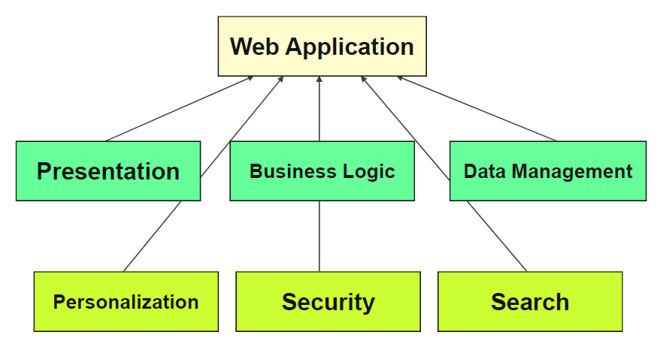
Web Application
Architecture of a web application consists of parts, called Tiers and Layers.
Each layer has some specific functionality to perform.
Presentation, business logic and data management are Layers.
Personalization, Security & Search are general functions or attributes of a web application.

Slide 4
Generic Web (Platform) Architecture
The Web “platform” is based on
It’s essentially a Client/Server architecture.
Transmission Control & Internet Protocols (TCP/IP)
Hyper Text Transfer Protocol (HTTP)
enable communications between clients and servers.
Hyper Text Markup Language (HTML)
Language to create hyper text documents(Web pages)
QUESTION ???
Language=HTML, Protocol=HTTP, WHO INTERPRETS the CODE..?
BROWSER
Interprets the HTML and sends the request.
But still things can get complex…
Components on the network ( firewall, proxy, load balancer)
Components in the intranet (Web server, applications, server, data base, legacy systems, web services).

Slide 5
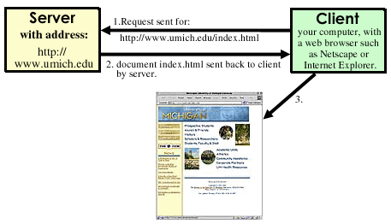
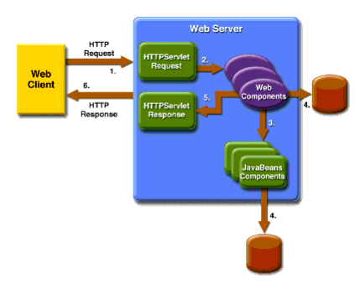
Client- Server Model
General view of Client server architecture
Handling an http request.
he Web browser submits an HTTP request message to the server.
The server provides resources such as HTML files and other content, or performs other functions on behalf of the client.
Returns a response message to the client.

Slide 6
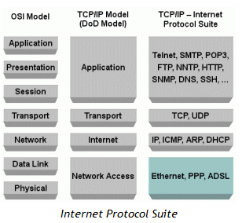
TCP/IP Protocol Suite
TCP/IP is the communication protocol for communication between computers on the Internet.
TCP/IP stands for Transmission Control Protocol / Internet Protocol.
TCP/IP defines how electronic devices (like computers) should be connected to the Internet, and how data should be transmitted between them.

Slide 7
More Protocols
Inside the TCP/IP standard there are several protocols for handling data communication:
TCP (Transmission Control Protocol) communication between applications.
TCP takes care of the communication between your browser and your network software.
TCP is responsible for breaking data down into IP packets before they are sent, and for assembling the packets when they arrive.
UDP (User Datagram Protocol) simple communication between applications.
IP (Internet Protocol) communication between computers.
IP is a "connection-less" communication protocol.
messages (or other data) are broken up into small independent "packets" and sent between computers via the Internet.
ICMP (Internet Control Message Protocol) for errors and statistics
DHCP (Dynamic Host Configuration Protocol) for dynamic addressing

Slide 8
More Protocols
SSL - Secure Sockets Layer
The SSL protocol is used for encryption of data for secure data transmission.
SMTP - Simple Mail Transfer Protocol
SMTP is used for transmission of e-mails.
MIME - Multi-purpose Internet Mail Extensions
The MIME protocol lets SMTP transmit multimedia files including voice, audio, and binary data across TCP/IP networks.
IMAP - Internet Message Access Protocol
IMAP is used for storing and retrieving e-mails.
POP - Post Office Protocol
POP is used for downloading e-mails from an e-mail server to a personal computer.
FTP - File Transfer Protocol
FTP takes care of transmission of files between computers.
ARP - Address Resolution Protocol
ARP is used by IP to find the hardware address of a computer network card based on the IP address.

Slide 9
Sending Email
What Protocols are used when an email is written?
What Protocols are used when email is to be sent?
What about attaching a picture or video file in email?
Multi-purpose Internet Mail Extensions
Your email program uses different TCP/IP protocols:
It sends your emails using SMTP
It can download your emails from an email server using POP
It can connect to an email server using IMAP

Slide 10
Domain Names
A name is much easier to remember than a 12 digit number.
Names used for TCP/IP addresses are called domain names.
google.com is a domain name.
When you address a web site, like http://www.w3schools.com, the name is translated to a number by a Domain Name Server (DNS).
When a new domain name is registered together with a TCP/IP address, DNS servers all over the world are updated with this information.

Slide 11
Hypertext Transfer Protocol (HTTP)
The Hypertext Transfer Protocol (HTTP) is an application protocol for distributed, collaborative, hypermedia information systems.
HTTP is the foundation of data communication for the World Wide Web (WWW).
HTTP works as a request-response protocol in the client-server computing model.
HTTPS - Secure HTTP
HTTPS takes care of secure communication between a web server and a web browser.
HTTPS typically handles credit card transactions and other sensitive data.
QUESTION…
IN WHAT WEB APPLICATIONS HTTPS IS USED..?

